Slide 1
ORIENTAL TURTLES
SWARM ROBOTIC
Project Progress Report
13/08/2013 (week 3)
by Peter Kang & Ken Neth Yeoh
ROSROSROSROSROSROSROSROSROSROSROSROSROS
Notes:
Hi, I’m Peter, and we are the oriental turtles.
This time, we are a bit more prepared than the last time when we didn’t have any ppt file to aid our presentation

Slide 2

Oriental Turtles
What we couldn’t show last time
Gantt Chart
WBS
ROSROSROSROSROSROSROSROSROSROSROSROSROS
Notes:
So, due to some technical glitch, we weren’t able to show these things.

Slide 3
Oriental Turtles
GANTT CHART
ROSROSROSROSROSROSROSROSROSROSROSROSROS
Notes:
Firstly, the gantt chart. Wow that looks massive. It’s bigger than I thought. Im not sure if that’s the correct spelling

Slide 4
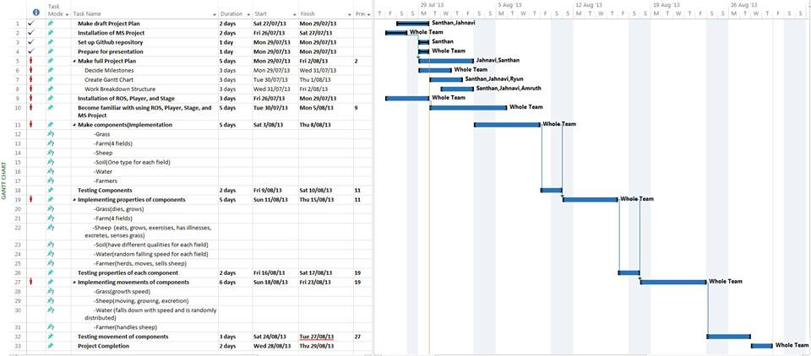
Oriental Turtles
Gantt Chart
ROSROSROSROSROSROSROSROSROSROSROSROSROS
Notes:
Yeah nothing much special. Looks pretty decent

Slide 5
Oriental Turtles
WORK
BREAKDOWN
STRUCTURE
ROSROSROSROSROSROSROSROSROSROSROSROSROS
Notes:
Now the work break down structure.

Slide 6
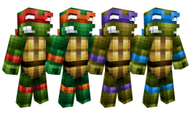
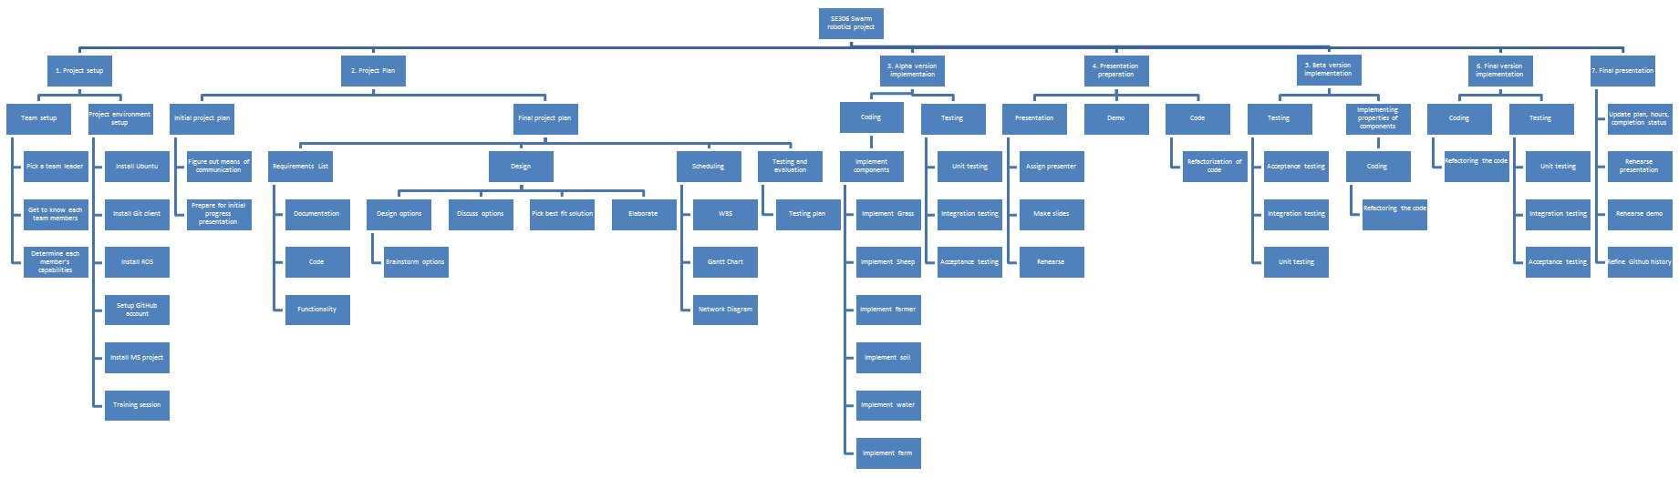
Oriental Turtles
WBS
7 main tasks
Based on Gantt chart and project requirements
ROSROSROSROSROSROSROSROSROSROSROSROSROS
Notes:
Yehh awesome. So here we have 7 main tasks. Its pretty much based on the gantt chart and the project description sheet.

Slide 7
Oriental Turtles
UML
ROSROSROSROSROSROSROSROSROSROSROSROSROS
Notes:
Ok another big letters

Slide 8
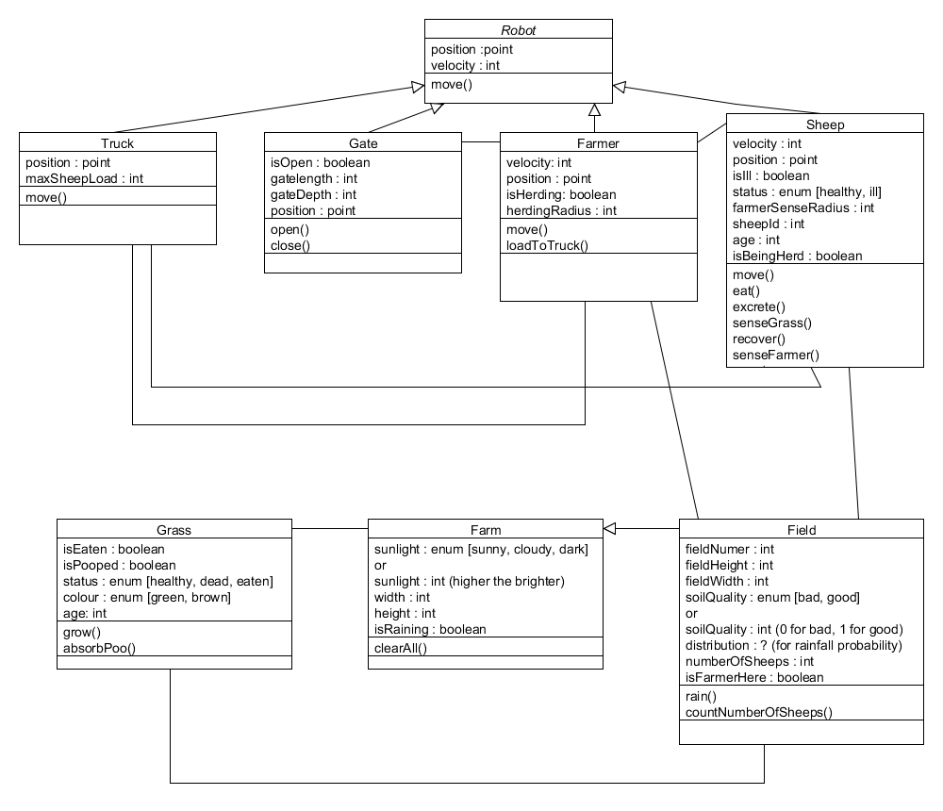

Oriental Turtles
UML CLASS DIAGRAM
Robot as super class
Yes, our grass can
absorb poo!
Our blueprint for coding
ROSROSROSROSROSROSROSROSROSROSROSROSROS
Notes:
So, here’s our class diagram for the project. It’s obviously not the final version at the moment,
but its based on our final design decision, so it although there may be some minor changes, the main bits are not going to change

Slide 9
Oriental Turtles
CURRENT
PROGRESS
ROSROSROSROSROSROSROSROSROSROSROSROSROS
Notes:
Now, about our current progress

Slide 10
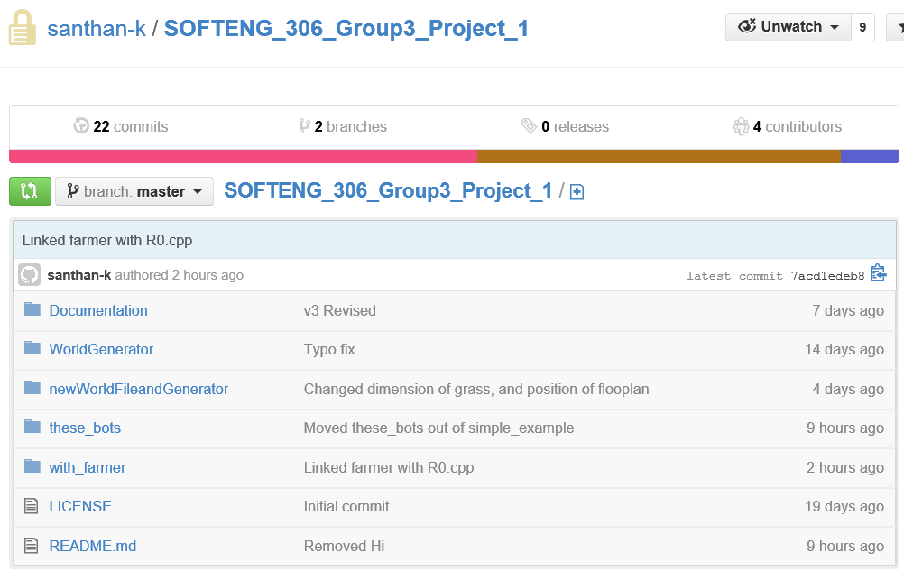
Oriental Turtles
ROSROSROSROSROSROSROSROSROSROSROSROSROS
Notes:
A screenshot of our github.

Slide 11
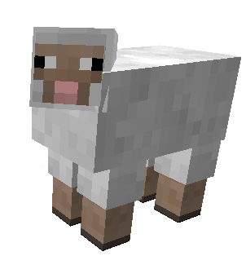
Oriental Turtles
Farm screenshot
ROSROSROSROSROSROSROSROSROSROSROSROSROS
Notes:
And a screenshot of our actual farm

Slide 12

Oriental Turtles
Current Progress…
Pretty much done with planning stage
Overall design is more refined
Yet flexible enough to allow future changes
Focusing more on coding
ROSROSROSROSROSROSROSROSROSROSROSROSROS

Slide 13

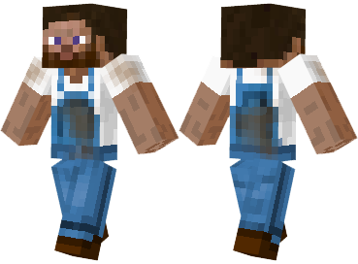
Oriental Turtles
LET’S WATCH
DEM FARMERS
by Ken Neth
ROSROSROSROSROSROSROSROSROSROSROSROSROS
Notes:
Ok before I talk about our coding stuff, Kenneth will guide you through the demo video of our farmer.

Slide 14
Oriental Turtles
Coding progress
Implementation of basic components
Farmer implementations :
Follows set pattern (for herding sheep)
World file
Grass, gates, farmer, sheep
Automation of world file creation
We can run the whole simulation in a single execution!
ROSROSROSROSROSROSROSROSROSROSROSROSROS
Notes:
Yeah, so this and that,

Slide 15
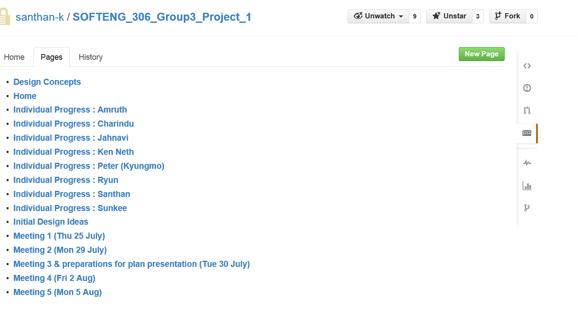
Oriental Turtles
Individual progress
Implementation of basic components
ROSROSROSROSROSROSROSROSROSROSROSROSROS
Notes:
Oh, we also have this thing called individual progress pages on wiki. It’ll be like a short summarized list of all the things that each member has done, or the current progress status of the task they’re working on

Slide 16

Oriental Turtles
That’s all for this week
Thank you!
ROSROSROSROSROSROSROSROSROSROSROSROSROS

Slide 17
UML
WBS
Current progress
Coding : farmer – following set pattern (will be used for herding sheep)
World file – grass, sheep, farmer, gates
We have automated the world file creation
We can run the whole sim in a single execution
Done Just basic attributes (non-moving)
Video clip of farmer
Screenshot of farm
Individual progress

